Slide 1
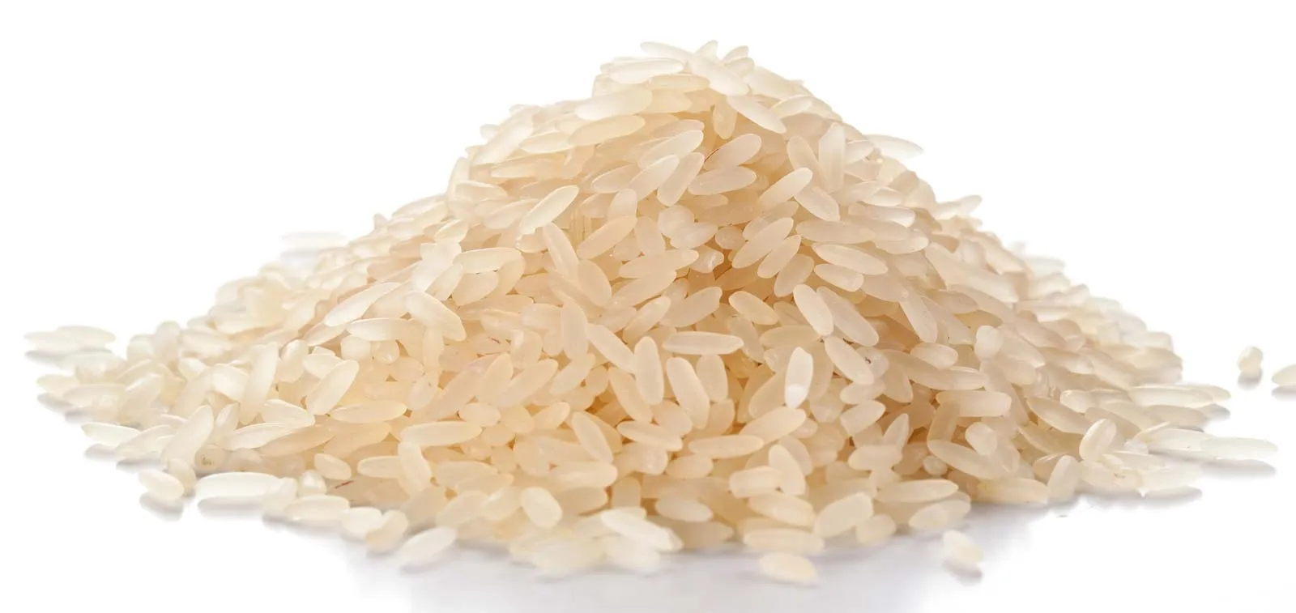
Enhancing Rice Variety Classification: A Deep Learning Approach
Andrew chen
Notes:
Good morning/afternoon/evening everyone,
Welcome to today's presentation on "Enhancing Rice Variety Classification: A Deep Learning Approach." I'm [Your Name], and I'm thrilled to have the opportunity to share our work on leveraging deep learning techniques to enhance the classification of rice varieties.
In this presentation, we'll explore how deep learning, specifically convolutional neural networks (CNNs), can significantly improve the accuracy and efficiency of crop classification tasks, with a focus on rice varieties. We'll delve into our dataset, preprocessing techniques, model architectures, performance evaluation, and the process of hyperparameter tuning to optimize our models.
Let's dive in!

Slide 2
Introduction
Introduction to Rice Variety Classification
Importance of Rice Classification
Challenges in Traditional Classification Methods
Role of Deep Learning in Crop Classification
Objectives of the Study
Goals of the Project
Key Research Questions
Expected Outcomes
Notes:
In this slide, we provide an overview of our presentation. We begin by introducing the concept of rice variety classification and emphasize its importance in agricultural research and food security. We discuss the limitations of traditional classification methods and highlight the potential of deep learning techniques, particularly CNNs, in overcoming these challenges.
Next, we outline the objectives of our study, including the project's goals, key research questions, and the expected outcomes. By setting clear objectives, we aim to address specific research gaps and contribute to the advancement of rice variety classification using deep learning methodologies.

Slide 3
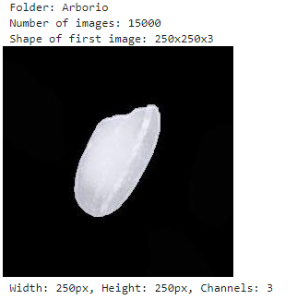
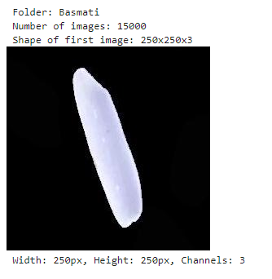
Data
Class Distribution
Arborio: 15,000 images
Basmati: 15,000 images
Ipsala: 15,000 images
Jasmine: 15,000 images
Karacadag: 15,000 images
Shape of Image: 250x250x3
Notes:
The dataset consists of 75,000 images representing five different rice varieties: Arborio, Basmati, Ipsala, Jasmine, and Karacadag. Each class contains 15,000 images.
Additionally, we detail the characteristics of the images, including their dimensions and color channels. All images are standardized to a size of 250x250 pixels with three color channels (RGB), ensuring uniformity across the dataset. Understanding these image characteristics is crucial for model training and evaluation.

Slide 4
Data Preprocessing
Image Data Organization:
Traversed through rice variety subfolders within the main directory.
Compiled a list of JPEG files, filtering for files with the ".jpg" extension.
Stored file paths in X_data and corresponding labels in y_data.
Data Splitting:
Utilized train_test_split from Scikit-learn.
Allocated 60% of the data for training, 20% for validation, and 20% for testing.
Maintained balanced label distributions across subsets.
Image Data Normalization:
Rescaled pixel values to a range of 0 to 1 using ImageDataGenerator.
Ensured consistency in data representation, aiding model convergence during training.
Data Generator Setup:
Constructed Pandas DataFrames (train_df, val_df, test_df) to organize image paths and labels.
Defined data generators using flow_from_dataframe for efficient loading and preprocessing of images during model training.
Notes:
In this slide, we delve into the critical aspect of data preprocessing, a foundational step in our rice variety classification project. Preprocessing ensures that our image data is structured and ready for model training. We begin by organizing the image data, traversing through the rice variety subfolders within the main directory and compiling lists of JPEG files while filtering for the ".jpg" extension. This step ensures that only relevant image files are included in our dataset.
Next, we tackle the task of splitting our data into distinct subsets for training, validation, and testing. This is achieved using the train_test_split function from Scikit-learn, where we allocate percentages of the data to each subset while maintaining balanced label distributions. This balance is crucial for training a robust and generalizable model.
Following the data splitting, we normalize the pixel values of our images to a range between 0 and 1 using the ImageDataGenerator. Normalization enhances model convergence during training by ensuring consistent data representation across images.
Finally, we set up data generators using Pandas DataFrames to organize image paths and labels. These generators, instantiated with flow_from_dataframe, efficiently load and preprocess images on-the-fly during model training. This approach streamlines the training process and facilitates batch processing, contributing to the scalability and effectiveness of our deep learning pipeline.
Overall, the data preprocessing phase lays the groundwork for successful model training and evaluation, ensuring that our neural network can effectively learn from the input data and make accurate predictions.

Slide 5
Model Architectures
Simple CNN Model
Two Convolutional Layers (32 and 64 filters) with ReLU activation
Max Pooling after each Convolutional Layer
Flatten Layer
Two Dense Layers (128 and 5 units) for Classification
Total Depth: 4 layers
Trainable Parameters: Approximately 372,485
VGG-like Model
Four Convolutional Layers (64, 128, 256, and 512 filters) with ReLU activation
Max Pooling after each Convolutional Layer
Flatten Layer
Two Dense Layers (512 and 5 units) for Classification
Total Depth: 8 layers
Trainable Parameters: Approximately 5,113,605
ReNet-like Model
Four Residual Blocks, each containing two Convolutional Layers with skip connections
Max Pooling after each Residual Block
Flatten Layer
Two Dense Layers (512 and 5 units) for Classification
Total Depth: 16 layers
Trainable Parameters: Approximately 8,490,117
Notes:
Introduces the three model architectures used in our project for rice variety classification. Each architecture is designed to capture different levels of complexity and features.
The Simple CNN model is the most straightforward, with two convolutional layers followed by max pooling and dense layers. It has the lowest depth among the three models but still achieves competitive performance.
The VGG-like model is more complex, with additional convolutional layers and filters. This architecture is known for its deep structure, allowing it to capture intricate patterns and features from the image data.
The ResNet-like model employs residual blocks with skip connections to address the vanishing gradient problem in deep neural networks. Despite its deeper structure, it aims to maintain model performance while preventing degradation issues.
Understanding the characteristics and complexities of each model architecture is essential for choosing the most suitable approach based on the specific requirements and constraints of the classification task.

Slide 6
Model Performance
Simple CNN Model:
Training Accuracy: 97.12%
Validation Accuracy: 98.83%
Training Loss: 0.087
Validation Loss: 0.037
VGG-like Model:
Training Accuracy: 94.84%
Validation Accuracy: 96.50%
Training Loss: 3.10
Validation Loss: 0.11
ResNet-like Model:
Training Accuracy: 19.64%
Validation Accuracy: 20.15%
Training Loss: 25725200.00
Validation Loss: 5077274.00
Notes:
The Simple CNN model demonstrates the highest training and validation accuracies, indicating strong performance in classifying rice varieties. Additionally, it has the lowest training and validation losses, suggesting effective convergence and minimal overfitting.
The VGG-like model also performs well, with competitive training and validation accuracies. However, its training and validation losses may be slightly higher compared to the Simple CNN model, indicating a slightly higher level of overfitting.
In contrast, the ResNet-like model exhibits significantly lower training and validation accuracies, indicating poor performance in classifying rice varieties. Additionally, it has much higher training and validation losses, suggesting issues with training stability and convergence.
Understanding these performance metrics is crucial for evaluating the effectiveness of each model architecture and determining which approach best suits our classification task.

Slide 7
Model Performance
Identify Hyperparameters:
Learning Rate, Dropout Rate, Number of Neurons
Establish a Search Range:
Learning Rate: [0.001, 0.01, 0.1]Dropout Rate: [0.2, 0.3, 0.4]Number of Neurons: [64, 128, 256]
Select Optimal Hyperparameters:
Best Parameters: Learning Rate - 0.001, Dropout Rate - 0.4, Neurons - 256
Notes:
We start by identifying the key hyperparameters, including the learning rate, dropout rate, and the number of neurons in the dense layers.
Next, we establish a search range for each hyperparameter, specifying a set of values or a range to explore during tuning.
The dataset is split into training, validation, and test sets to facilitate model evaluation and hyperparameter optimization.
The models are then trained with various hyperparameter combinations, and cross-validation is utilized to assess their performance on the validation set.
Following training, we select the optimal hyperparameters based on the combination that yields the best validation performance, which in this case are: Learning Rate - 0.001, Dropout Rate - 0.4, Neurons - 256.
Finally, we evaluate the chosen model setup on the test dataset to obtain an unbiased assessment of its performance and generalization ability.
This rigorous approach to hyperparameter tuning ensures that our models are finely tuned to deliver optimal results for the rice variety classification task.

Slide 8
Conclusion
Conclusion:
Our rice variety classification project employed various model architectures, including Simple CNN, VGG-like, and ResNet-like models, to classify rice varieties based on images.
Performance comparison revealed that the Simple CNN model outperformed the other architectures, achieving the highest training and validation accuracies with minimal overfitting.
Hyperparameter tuning further enhanced model performance, with the best parameters identified as learning rate: 0.001, dropout rate: 0.4, and neurons: 256.
The systematic approach to model selection, evaluation, and hyperparameter optimization ensures robust and accurate classification of rice varieties.
Next Steps:
Explore additional data augmentation techniques to further improve model generalization and performance.
Investigate ensemble learning methods to combine predictions from multiple models for enhanced accuracy.
Extend the classification task to include more rice varieties or other agricultural products for broader application.
Collaborate with domain experts to incorporate domain-specific features and knowledge into the classification models for better interpretation and performance.
Notes:
We have demonstrated the effectiveness of employing deep learning models, specifically the Simple CNN architecture, for accurately classifying rice varieties based on images.
Moving forward, we plan to explore advanced data augmentation techniques to increase the diversity of our training data and improve model generalization.
Additionally, ensemble learning methods offer a promising avenue for further boosting classification accuracy by leveraging the strengths of multiple models.
Expanding the classification task to include more rice varieties or other agricultural products could broaden the application of our models and contribute to agricultural research and development.
Furthermore, collaborating with domain experts will enable us to incorporate domain-specific features and knowledge into our models, enhancing their interpretability and performance in real-world agricultural settings.
In conclusion, our project demonstrates the power of deep learning in agricultural applications and paves the way for future advancements in crop classification and monitoring.

Slide 9
References
Koklu, M., Cinar, I., & Taspinar, Y. S. (2021). Classification of rice varieties with deep learning methods. Computers and Electronics in Agriculture, 187, 106285. DOI: 10.1016/j.compag.2021.106285
Cinar, I., & Koklu, M. (2021). Determination of Effective and Specific Physical Features of Rice Varieties by Computer Vision In Exterior Quality Inspection. Selcuk Journal of Agriculture and Food Sciences, 35(3), 229-243. DOI: 10.15316/SJAFS.2021.252
Cinar, I., & Koklu, M. (2022). Identification of Rice Varieties Using Machine Learning Algorithms. Journal of Agricultural Sciences. DOI: 10.15832/ankutbd.862482
Cinar, I., & Koklu, M. (2019). Classification of Rice Varieties Using Artificial Intelligence Methods. International Journal of Intelligent Systems and Applications in Engineering, 7(3), 188-194. DOI: 10.18201/ijisae.2019355381

